Slide 1
High Altitude Ballooning As An EagleSat Testing Opportunity
Presented by
Zach Henney

Slide 2
Overview
Background
HASP Proposal Process
Current Design
Integration and Testing
Current Status
Future Work

Slide 3
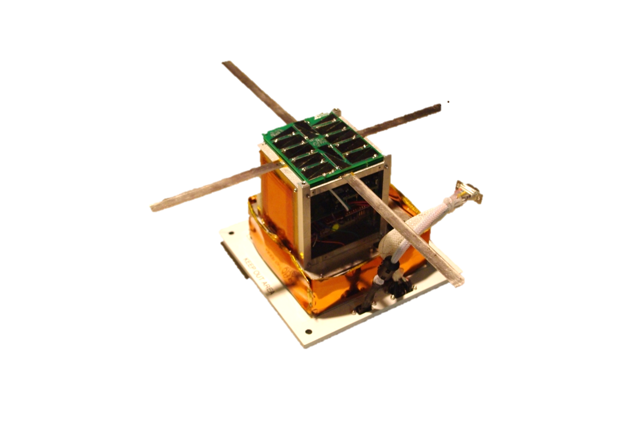
Background
In preparation for EagleSat’s
2015 delivery, high altitude
testing will be conducted on
the 2014 HASP
balloon flight
Builds upon testing of early
EagleSat systems on the
2013 HASP flight

Slide 4
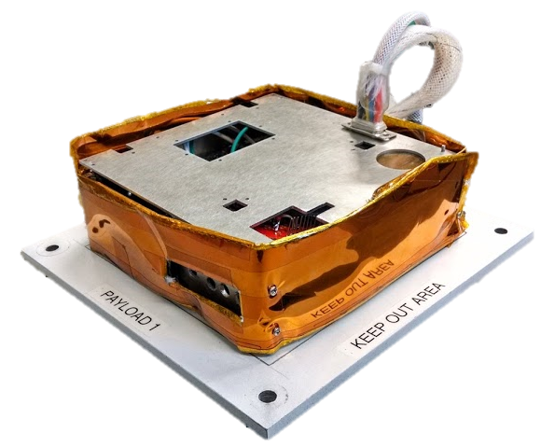
Background
Nest Integration Module
Interfaces between HASP
systems and
EagleSat
Controls power
delivery to
EagleSat, brings
data down from
EagleSat to HASP

Slide 5
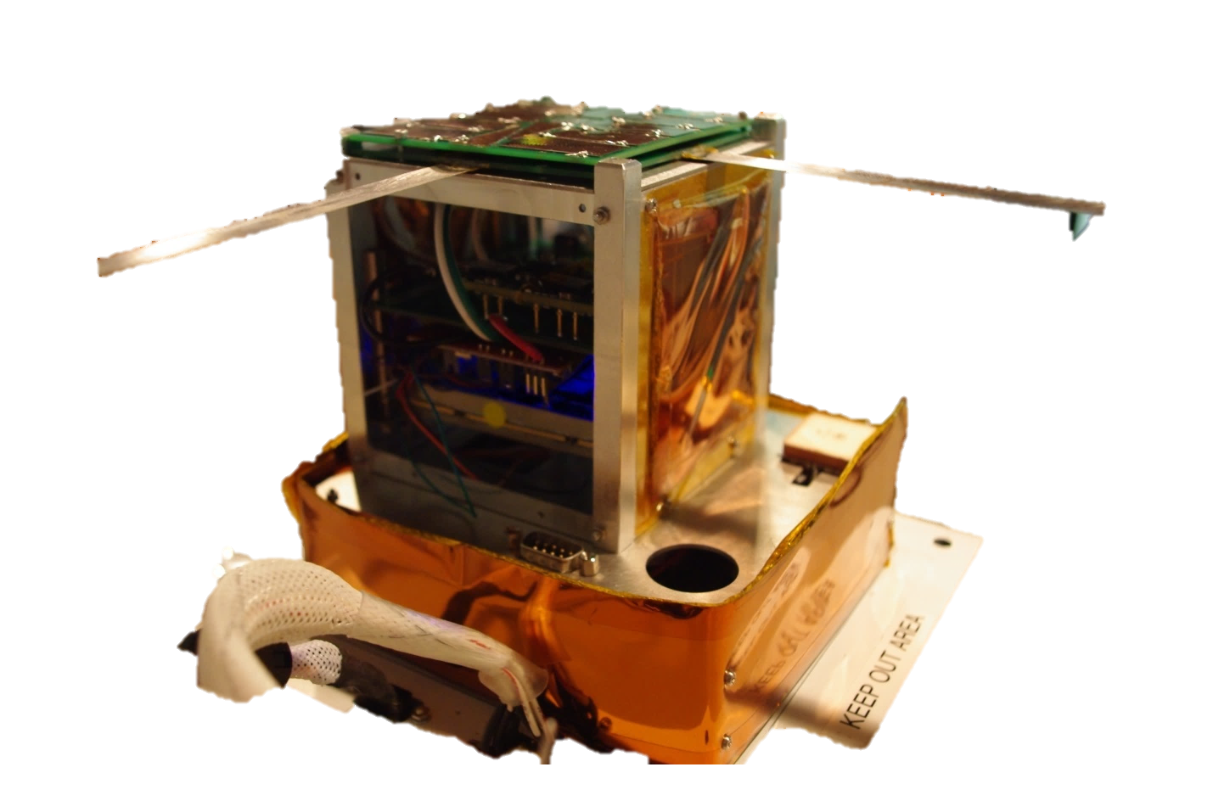
Background
EagleSat Test Model
Includes key systems:
  Power, Communications,
  OBC, Memory Tests,
  Pumpkin Structure
Will rely on solar panels
instead of HASP for
power (when possible)

Slide 6
HASP Proposal Process
Detailed the goals of the EagleSat program and the need for a space-like testing environment
  Testing on a long duration, near-space flight would offer a systems test that could not be easily recreated in a laboratory environment
  Would utilize NASA resources to test the payload prior to delivery to NASA in 2015
Would utilize and build off hardware used on 2013 HASP flight

Slide 7
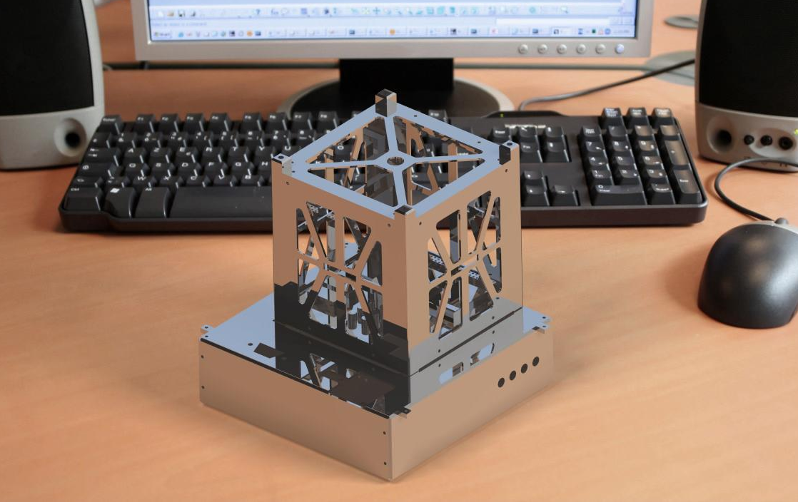
Current Design

Slide 8
Integration and Testing
Testing begins after Nest and EagleSat have been integrated
Will conduct a series of hot and cold cycles while communicating over serial
  Temperatures range from -60 to 60°C
  Tests will range from 12 to 24 hours
Further testing in vacuum chamber
  Will hold payload at 460 kPa (flight pressure)
  Tests will range from 12 to 24 hours

Slide 9
Current Status
Solar panels under assembly
Electrical, OBC, and Communications systems undergoing testing
Nest structure being adapted to fit Pumpkin structure
Nest electronics undergoing tests to confirm compatibility with both HASP and EagleSat

Slide 10
Future Work
Complete assembly of both Nest and EagleSat
Begin on-campus integration and testing
Take payload to Palestine, TX for HASP Integration
Flight scheduled for end of August / Start of September

Slide 11
Thank you for listening.
Zach Henney
henneyz@my.erau.edu

